Slide 1
Chapter 6
Growth

Slide 2
Growth in History
Up to ~500 years ago, most lived in conditions we would call abject poverty
Today: Income levels much higher and more diverse
Big minority of the world’s population has achieved rapid, sustained income growth
  Others, more modest->middle income
  Majority: in poverty (though usually better off than their ancestors)
What a difference a century makes (book)

Slide 3
Contrasting Growth Experiences

Slide 4
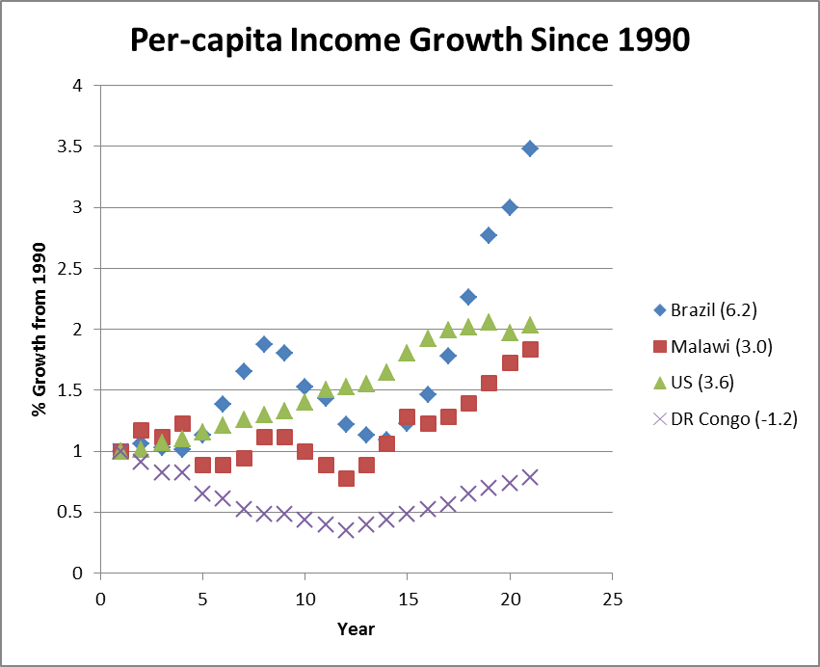
Why Do Some Countries Grow Faster Than Others?

Slide 5
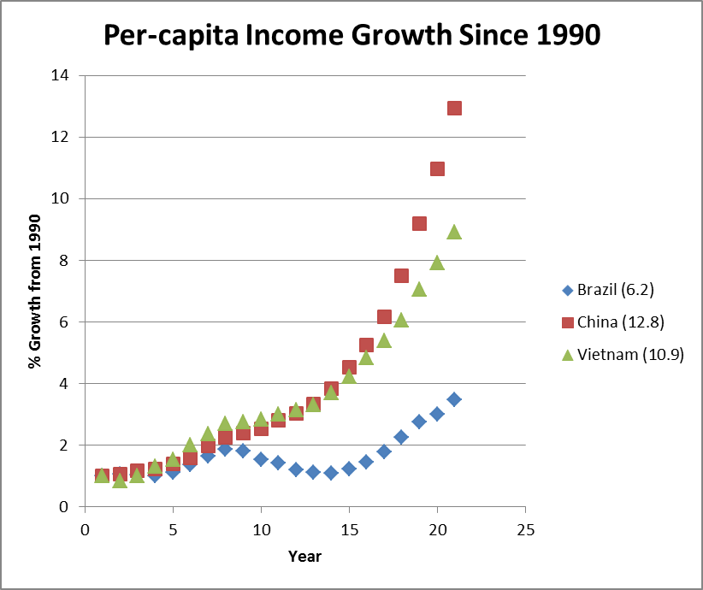
…And Some Grow Very Fast?

Slide 6
What Explains This? (The Quest for the Holy Grail of Growth)
Factor accumulation: Increasing size of the capital stock (or labor force)
  Machines, factories, buildings, roads, computers, etc.
Productivity growth: Increasing the amount of output produced by each machine or worker
  Use technologies you have more efficiently
  Technological change

Slide 7
Starting Point: How Does Income Get Produced?
By combining labor (L) and capital (K)
Technology described by an Aggregate Production Function:

Slide 8
A Basic Growth Model
So…Grow the economy by raising savings (Harrod-Domar Model)

Slide 9
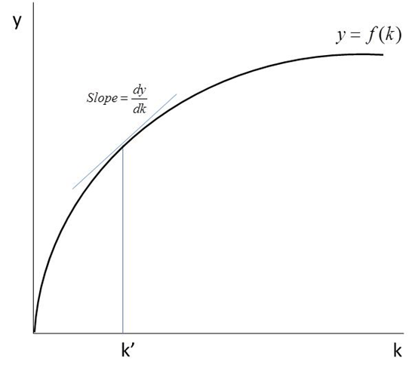
The Solow Model (Neoclassical Growth Model)

Slide 10
The Solow Equation

Slide 11
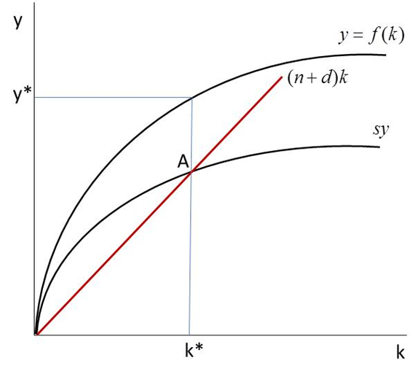
The Solow Diagram
Steady State: Where Δk=0
Point A: Steady state, long run, or potential output per worker
(What happens when n, d, s change?)
(How about technological change?)

Slide 12
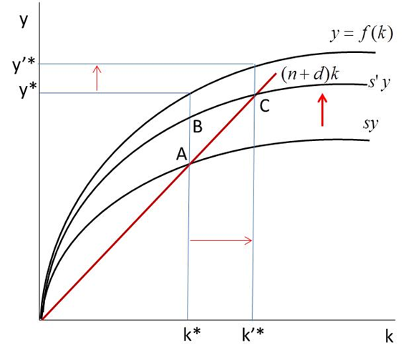
A Higher Savings Rate Raises Income/Worker

Slide 13
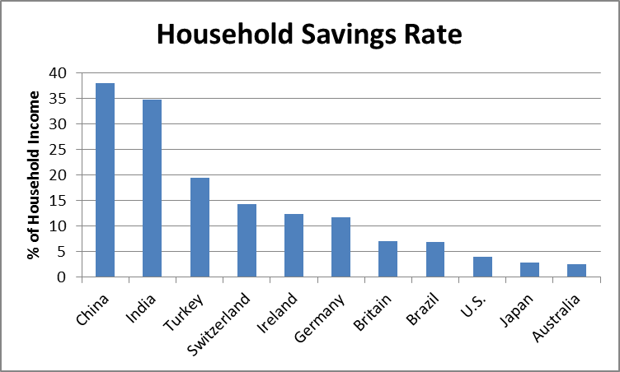
Can the Savings Rate Be Too High?
Chinese people older than 50 save more than 60 percent of their income. They remember the “bitter years:”
- the Great Famine (1958 to 1961)
- violence of the Cultural Revolution (1966 to 1976)
One young Chinese man said: “Maybe I’m too busy to have a lot of time spending money.”
Source Data: OECD, World Bank, Standard Chartered, Turkish State Planning Office, British Office for National Statistics
http://www.businessweek.com/printer/articles/46918-how-household-savings-stack-up-in-asia-the-west-and-latin-america
Keith B. Richburg, “Getting Chinese to stop saving and start spending is a hard sell.” The Washington Post, 7/5/2012,
http://www.washingtonpost.com/world/asia_pacific/getting-chinese-to-stop-saving-and-start-spending-is-a-hard-sell/2012/07/04/gJQAc7P6OW_story.html

Slide 14
Explaining Household Savings http://www.businessweek.com/printer/articles/46918-how-household-savings-stack-up-in-asia-the-west-and-latin-america
China: 38%
  No national safety net
India: 34.7%
  India's savings rate has been building along with the acceleration of its GDP growth
Turkey: 19.5%
  Turkish savings, high by U.S. standards, are not enough for a developing country
Switzerland: 14.3%
  The Swiss vie with Swedes and Austrians to be the top savers in the West
Ireland: 12.3%
  The Irish savings rate quadrupled over two years in response to the financial crisis
Britain: 7%
  British savings have declined sharply since the early 1990s
Brazil: 6.8%
  Latin American economies generally have low savings rates
U.S.: 3.9%
  U.S. savings are up from a 1.7% low but far below a postwar average of 7% or so
Japan: 2.8%
  The savings decline in Japan from 15% in 1992 is the most dramatic in the industrialized world
Austraila: 2.5%
  The Australians, like the Americans, have had a huge housing boom compensating for the loss in savings

Slide 15
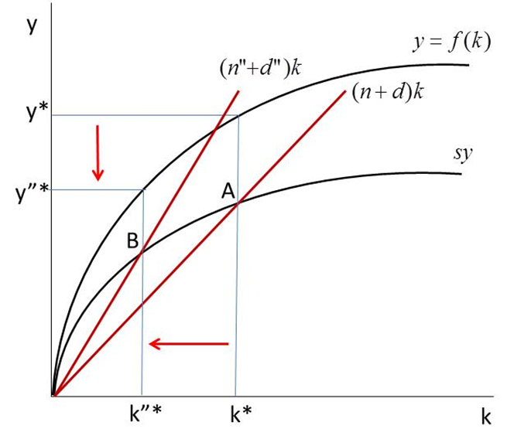
Higher Population Growth or Depreciation Do the Opposite

Slide 16
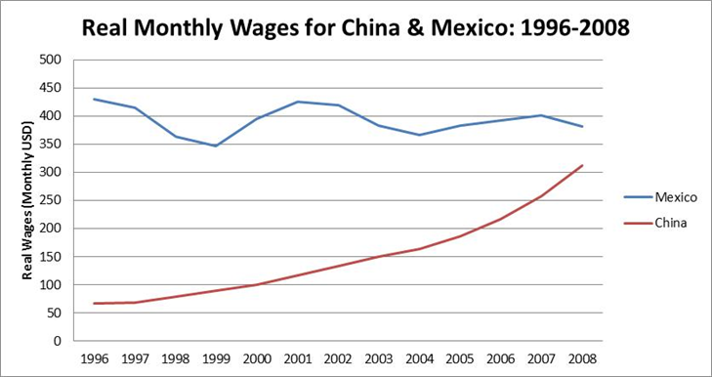
Some Testable Implications of the Solow Model
√ Big success stories have growing capital per worker
  China, Asian Tigers confirm this
  Higher k means higher productivity, wages

Slide 17
You Always Come Back to the Steady State
√ Shocks can throw economies off their steady state—but they eventually return
  See the bombing Vietnam box
  Berkeley and Oakland after the ’91 fire
  New Orleans after Katrina?

Slide 18
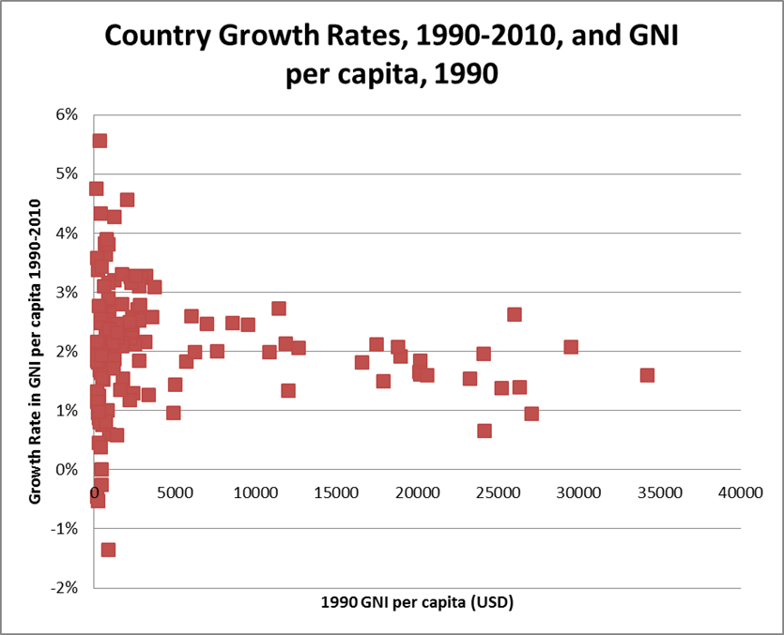
The Convergence Hypothesis
Given s and n, countries’ incomes should converge. Lower income, higher growth?
Are poor countries growing faster than rich ones?
-Hard to see

Slide 19

Growth in aggregate income should be explained by growth in labor and capital.
Is it?
“I Just Ran Two Million Regressions.”
Xavier X. Sala-I-Martin, American Economic Review 87(2): 178-83, 1987.

Slide 20
Things Explaining Growth
Capital investment
Political rights
Openness to trade
Black markets
Colonial legacy
War
Religion
…to name a few

Slide 21
The Biggest Question of All
What explains the production function?
  That’s where technological change is
Henry Ford, the internet, and my teeth
Concentration of technological change in rich countries keeps convergence from happening (increasing returns to scale)
What makes production functions change?

Slide 22
Endogenous Growth
S
Keys to Increasing Returns to Scale
Technological change (new f(k))
Spillover effects
Agglomeration effects

Slide 23
From Solow to Endogenous (“New”) Growth Models
Key difference: Increasing Returns to Scale: Doubling inputs more than doubles output. How?
Positive externalities:
  Effect of my education on yours
  Spread of new ideas (e.g., Ford’s assembly line; “spillovers”)
  R&D Investments -> new knowledge benefiting everyone
  The internet
  Digital bite wings at the dentist
  Growth perpetuates itself through technological change
  Does this apply to LDCs?
    They can grow rapidly by adapting technologies developed in countries with high R&D capability
Agglomeration facilitates this (Silicon Valley, Bangalore)

Slide 24
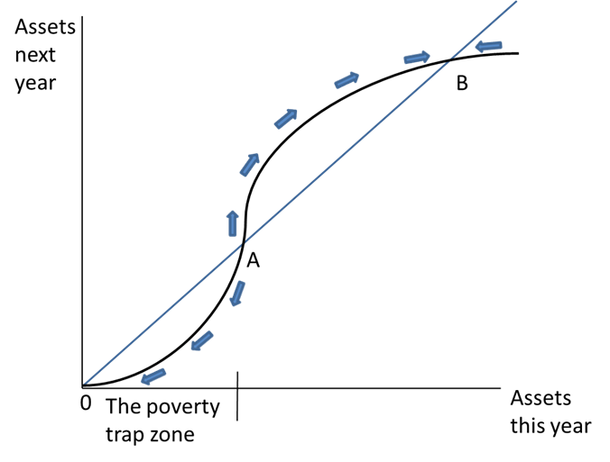
A Different Kind of Steady State: The Poverty Trap
(from Chapter 3)

Slide 25
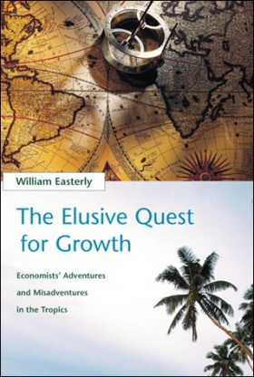

What’s the Answer, Then?
Easterly vs. Sachs
William Easterly (The Elusive Quest for Growth): Getting incentives right; how aid can be bad
Jeffrey Sachs (The End of Poverty): The millennium villages: Development with massive aid
Who’s Right?

